Slide 1
Airline Passenger Satisfaction Prediction using ML
By: Sandhya Kshirsagar
7 May 2025

Slide 2
Problem Statement:
This project aims to develop a machine learning model that predicts whether a customer is "Satisfied" or "Neutral/Unhappy" based on various factors including demographic details, travel characteristics, and service-related ratings such as booking ease, inflight service, cleanliness, entertainment, and more. By identifying the key drivers of satisfaction, airlines can take proactive steps to enhance passenger experiences, optimize operations, and make informed, data-driven decisions to improve overall customer engagement.

Slide 3
The airline industry places a strong emphasis on customer satisfaction, recognizing it as a key driver of loyalty, brand reputation, and overall success. This focus extends across various touchpoints, including reservations, check-in, boarding, in-flight service, and issue resolution, with airlines striving to create a positive and seamless travel experience.
Machine Learning can help automate this complex analysis, uncover hidden patterns, and make predictions with high accuracy. This will allow the airlines to make more informed, data-driven decisions.
Steps followed in building the ML model to make predictions:
Data Description:
Understanding the data and its components.
Performing some EDA to help understand the data
Data Preprocessing:
Cleaning the data, Encoding,
Feature Scaling,
Feature Engineering
Model building:
Build multiple models to see which one works best for the dataset
Model Evaluation:
Evaluate the model filter out the model that gives the most accurate prediction with minimum error

Slide 4
Dataset Overview
01
02
03
04
05
Shape:
24 features
1,29,880 rows
Demographic Features:
ID
Age,
Gender,
Type of Travel,
Class
Flight Details:
Flight Distance
Departure Delay
Arrival Delay
In-flight services
Food and Drink
Entertainment
Seat comfort
Airline details:
Booking,
Check in
Gate location
Boarding
Baggage
Target Variable
Satisfaction:
Satisfied
Neutral/Dissatisfied
Most of the data is categorical data, out of the 24 features; 4 features are numerical values rest are all categorical data. The Airline details and some of the flight detail features are of ordinal type. The values range between 0 to 5; where 0 is not applicable , 1 is the lowest and 5 is the highest.

Slide 5
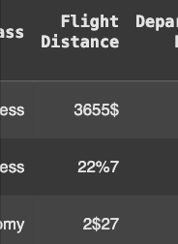

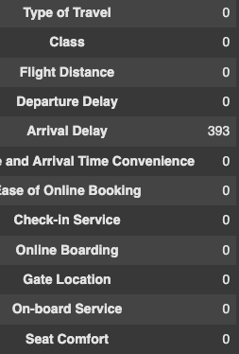
Data Cleaning
Convert Flight Distance to numeric datatype
Treating Null values
Null values were detected in ‘Arrival Delay’ feature.
Comparing the Departure Delay values with Arrival Delay.
Imputing Arrival Delay null values with corresponding Departure Delay values
Identifying and removing special characters from the data values using Regex
Converting the data type to integer.

Slide 6
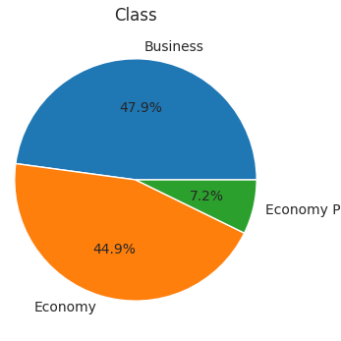
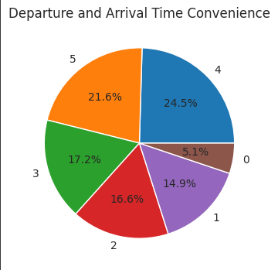
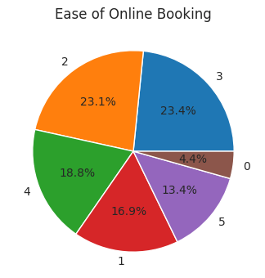
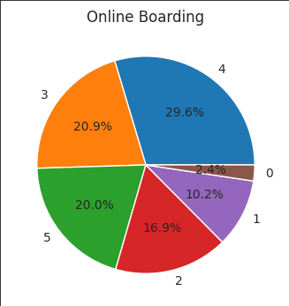
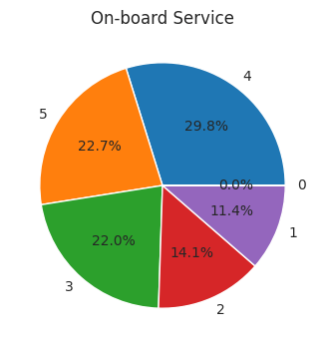
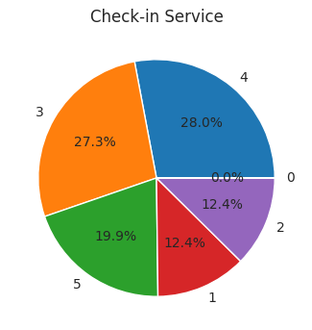
Exploratory Data Analysis
Categorical Features
Class
Departure and Arrival time convenience
Ease of online booking
Online Boarding
On-board Service
Check-in Service
Most of the passengers are Business class travellers and Economy class travellers. Very few are travelling by Economy Plus
The satisfaction rate of the passengers in regards to departure and arrival time is on the higher side (5 and 4), this could be because over 50% of the flights have departed and arrived on time without any delay.
Most of the passengers have opted for online booking and their ratings are average, mostly between 2-3. There are some passengers who did not opt for this service. 4.4%
The online boarding service gets a good number of ratings of 3,4,5. There are very few who did not use this online boarding service 2.4%
.Most of the customers look like they are satisfied with the on board service as the max ratings are between 4-5
Check in service got most of the ratings as 3-4. This could be because, these days a lot of passengers prefer the online services when it comes to check in.

Slide 7
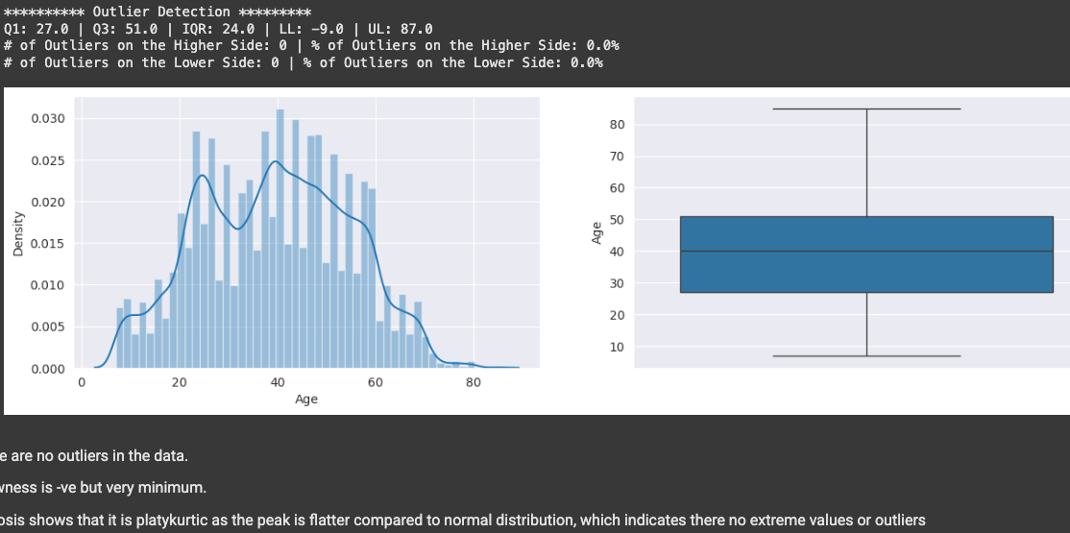
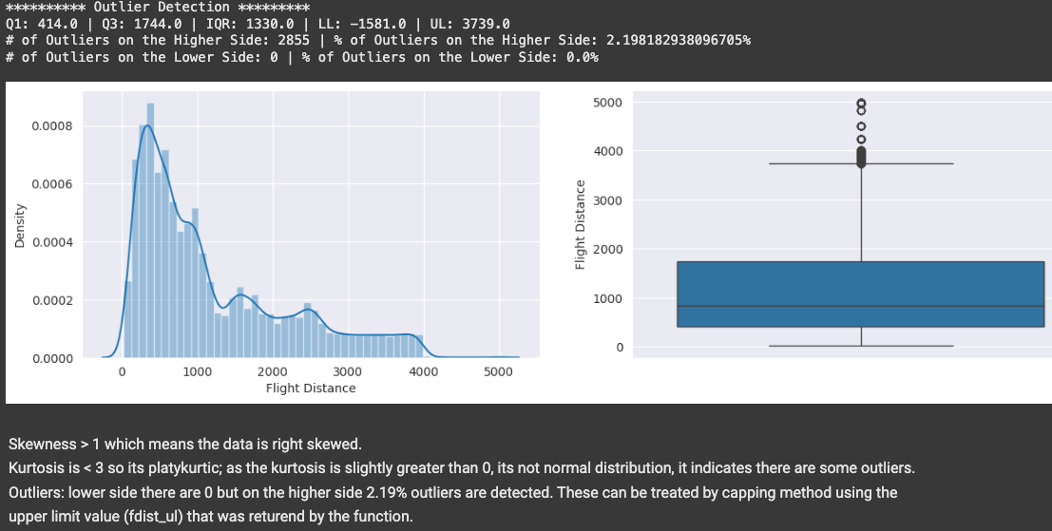
Exploratory Data Analysis
Numerical Features
Age
Age column has no missing values. The minimum age of the passenger is 7 years and maximum age is 85 years. Average age is 40.
The data is mostly normally distributed. There are no outliers detected. There is a slight amount of negative skewness.
Zero outliers
Very little negative skewness
Kurtosis is platykurtic
Flight Distance
No missing values in Flight Distance. Minimum distance is 31 miles and maximum distance is 4983. Average distance is 844 miles.
2.19% of outliers are detected on the higher side. These are treated by capping method.
Skewness can be treated by square root transformation.
Outliers detected on the higher side
Skewness is positive
Kurtosis is platykurtic

Slide 8
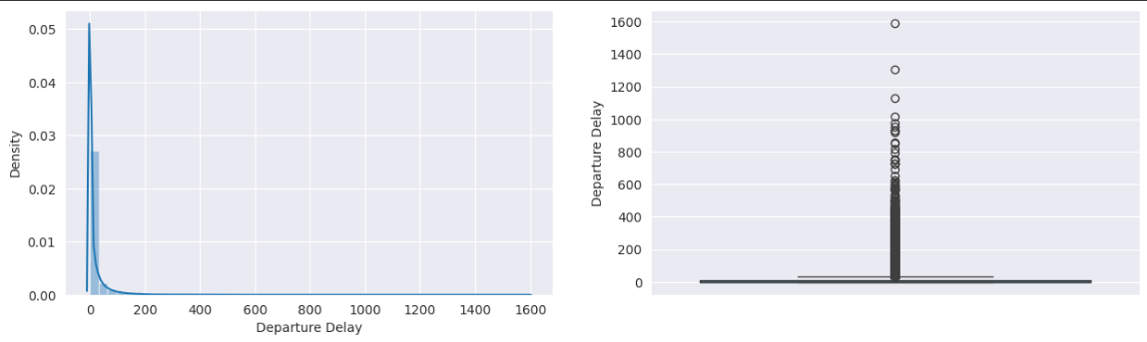
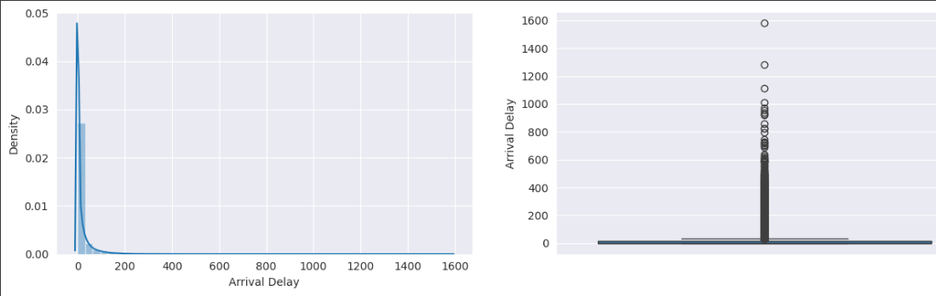
Departure Delay
Arrival Delay
Departure delay had a very high skewness, kurtosis and a lot of outliers.
Minimum value was 0 and maximum value was 1592 minutes which is approximately 26 hours.
56% of the data has 0 delay
43% of data had delay.
89% have experienced a delay less than 1 hour.
10% experienced a delay of more than 1 hour.
As most of the data for Departure delay feature falls close to 0, we can convert this feature to binary values 0 or 1. Where, zero delay is represented by 0 and rest are represented by 1.
Arrival delay had a very high skewness, kurtosis and a lot of outliers.
Minimum value was 0 and maximum value was 1584 minutes which is approximately 24 hours.
56% of the data has 0 delay
43% of data had delay.
88% have experienced a delay less than 1 hour.
10% experienced a delay of more than 1 hour.
As most of the data for Arrival delay feature falls close to 0, we can convert this feature to binary values 0 or 1. Where, zero delay is represented by 0 and rest are represented by 1.

Slide 9
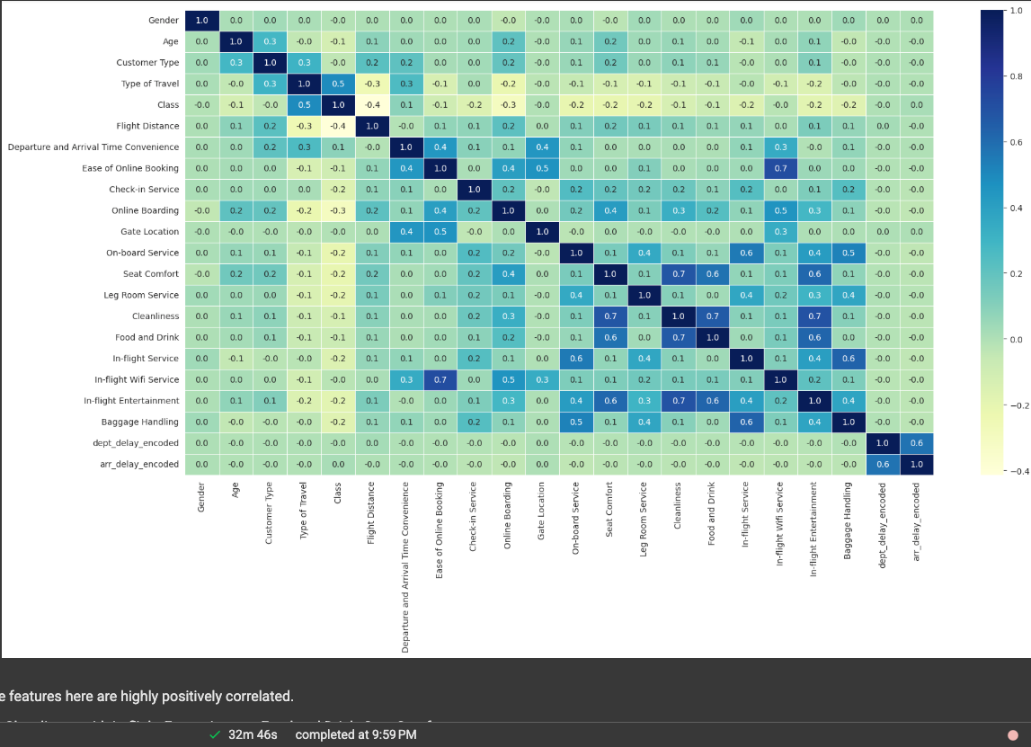
Correlation Heat Map
Some features here are highly positively correlated.
Cleanliness with In-flight Entertainment, Food and Drink, Seat Comfort.
Ease of online booking with n-flight wifi service
On-board Service with In-flight service
In-flight service with baggage handling
In-flight wifi service with Ease of online booking

Slide 10
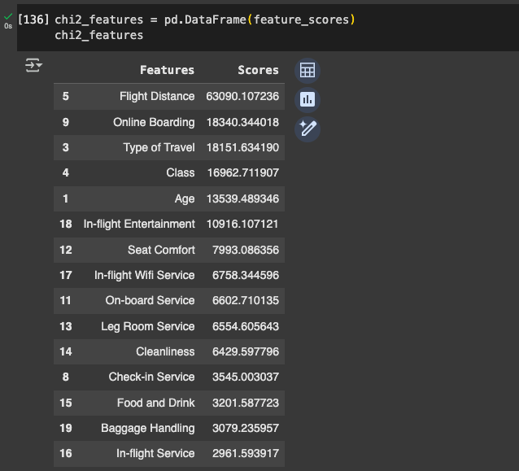
Feature Selection
Selecting best features using Chi2 test. I have used the Select KBest method from sklearn to run the Chi2 test and select the best 15 features.

Slide 11
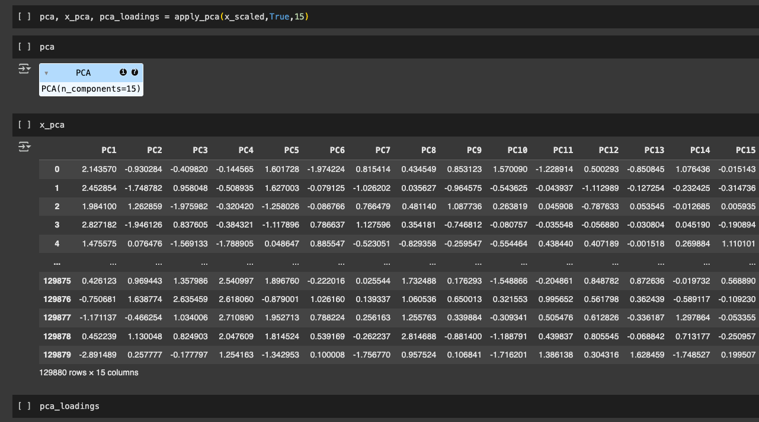
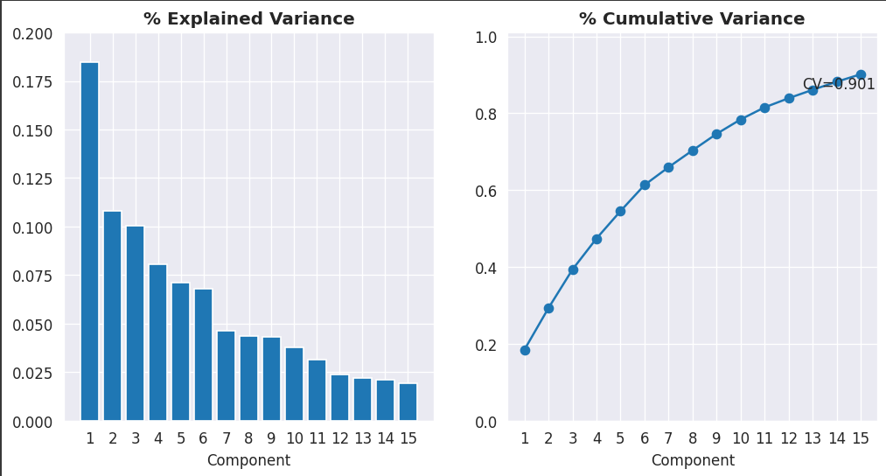
Feature Selection using PCA
Reducing the number of features and selecting the important features using PCA. Here, I am selecting 15 components.

Slide 12
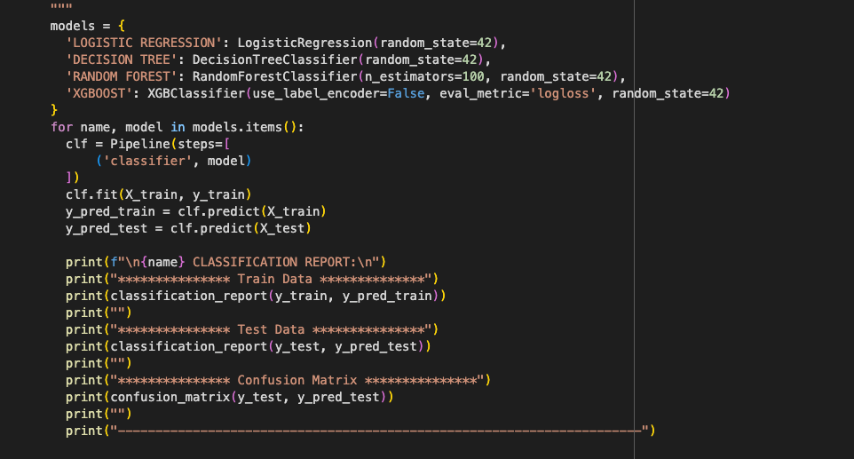

Model Pipeline
Creating a pipeline for building models.
I have used 4 classification models here:
Logistic Regression
Decision Tree
Random Forest
XGBoost
Applying this pipeline to original dataset, Chi2 dataset and PCA dataset.

Slide 13
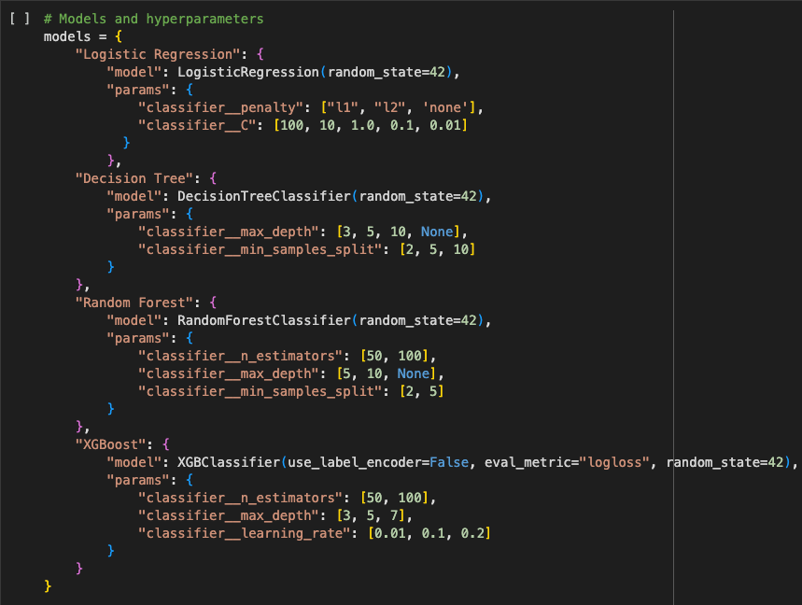
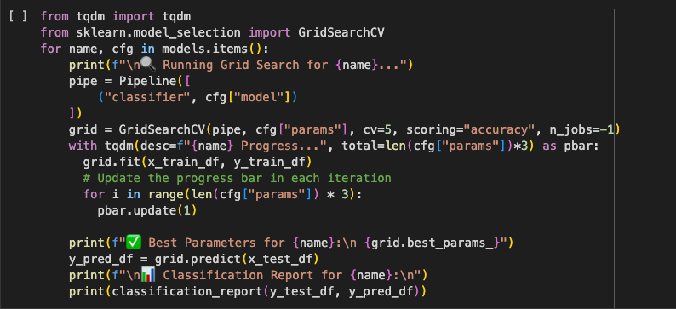
Hyper Parameter Tuning using Grid Search CV
Creating a dictionary of parameters for the 4 models applied in the pipeline. These parameters are passed to the Grid Search CV
Applying this Grid search CV to the three datasets: Original dataset, Chi2 dataset and PCA dataset.

Slide 14
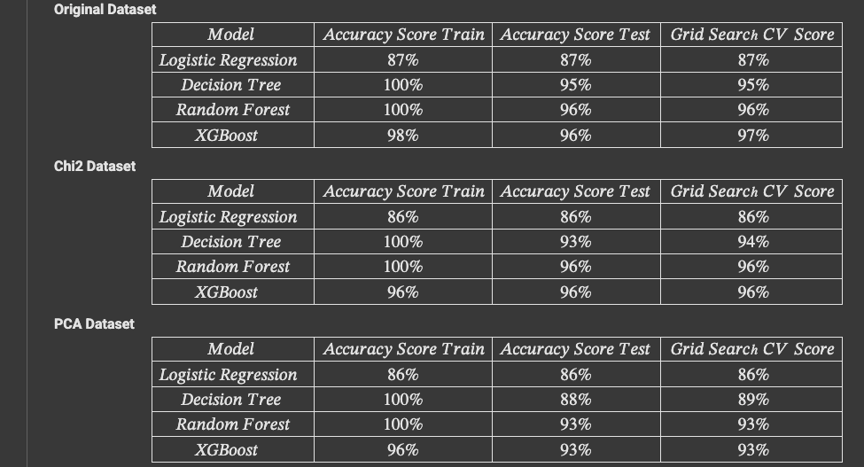

Airline Passenger Satisfaction Prediction using ML
Consolidated table of Accuracy scores after running all the models with the different datasets and applying Grid Search CV.

Slide 15

Final Thoughts
Out of all the model accuracy scores, XGBoost is giving the highest accuracy score of 97% when run with the original dataset containing all the features.
The best hyper parameters for XGBoost Classifier model are:
Classifier__learning_rate: 0.2
Classifier__max_depth: 7
Classifier__n_estimators: 100

Slide 16
Thank you

